Slide 1
TensorFlow II

Slide 2
Housekeeping
How was last week's homework?
Office hours
Normally Fridays, except tomorrow this week
Whoever was asking about figuring out particle collision locations with neural networks come see me after class, I want to clarify a few things
A handful of people haven’t done either homework but have done the all the labs and quizzes, if this is you please see Matt after class
The video from last week will be meaningfully delayed
https://browser.geekbench.com/opencl-benchmarks
Why CUDA transpiling won’t work
Unofficial OpenCL backends
TensorFlow.keras vs Keras
I’ll still be teaching core TF for obvious reasons, but for most tasks you’ll encounter in personal work I officially recommend this as the framework of choice
Stack overflow survey
TensorFlow
Take a look at the GitHub for explanations of doing other ML in TF if you want to
Were the documentation links helpful?
Tf.layers
If you can you’ll really want to get set up so that you can run tasks on your laptop soon

Slide 3
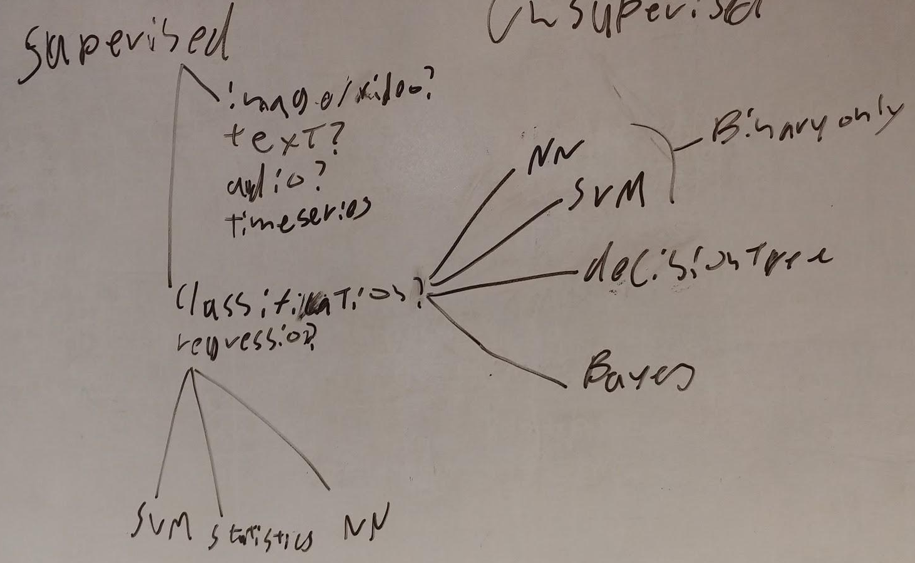
This is not totally accurate

Slide 4
https://github.com/aymericdamien/TensorFlow-Examples/blob/master/notebooks/3_NeuralNetworks/convolutional_network_raw.ipynb

Slide 5
GPU Usage
You can’t use GPUs for as part of the free trial on GCP
I was led to believe that you could
They only cost 30 cents per hour but require a $70 deposit to increase your quota
Only available in certain zones for those of you who want to do this yourself
I didn’t want you all to have to pay that, so I paid it and I’m running a server with a GPU you can SSH into
It’ll run for a few hours a day on a schedule I’ll announce
If you have a local CUDA enabled GPU you can use instead, please use it
Don’t break other people’s things
Don’t break the server
Don’t change the data preloaded to the server
Yes people can run multiple things on the GPU at once
For small neural nets they won’t even run slower
IF YOU’RE DOING SOMETHING THAT REQUIRES USING SUDO YOU’RE DOING SOMETHING WRONG AND YOU SHOULD ASK ME INSTEAD

Slide 6
Notes on local installs
Laptop switching issue
Notes on installation process are on the course github
Use in TensorFlow by only having tensorflow-gpu installed in pip
Configuration of everything takes around 90 minutes for my level of knowledge (plus linux install if you need that)
Unless you already have Linux and an nvidia driver on your laptop don’t do it today
CUDA 3.5 or greater from this list
https://developer.nvidia.com/cuda-gpus (click geforce for consumer cards)
1GB of ram or greater
Show of hands- who has an Nvidia GPU you can use?
If they’ll let you, running this on deepthought or labs workstations is fine
Deepthoughts GPUs are terrible compared to deepthought

Slide 7
Lab/Homeworks
Due at the start of the class after next, all in TF with lower level APIs (no keras, layers )
Next week I’ll go through a TF RNN and layers (?) examples
These are large data sets, please only download the one you want to look at first on to your laptop at the start of class (if you’re using a laptop), if you don’t you’ll nuke the wifi
RNN
https://www.kaggle.com/borismarjanovic/price-volume-data-for-all-us-stocks-etfs
Both GOOGL (Alphabet class A) and APPL (Apple), with transfer learning from one to the other
Predict close value of each day
So you don’t copy the winning Kaggle code, no LSTMs allowed
(I know, but finding good public RNN data is hard)
CNN
Classify image as the type of flower they are
https://www.kaggle.com/alxmamaev/flowers-recognition
OpenCV https://stackoverflow.com/posts/7776579/edit
Black to square
Please don’t run this on the GPU instance during class today

Slide 8
Lab/Homeworks
Autoencoder
Maximize MAE of autoencoder output
Smallest layer can’t be larger than 15% of the area you transform the images to
Use convolutional layers
https://www.kaggle.com/alxmamaev/flowers-recognition
Your choice of NN
https://archive.ics.uci.edu/ml/datasets/adult
Literally just do what the site says, the explanation is great
Ignore adult.test
Show Matt you accomplished something meaningful for lab credit
200 homework points, some graded as homework some as lab (TBD)

